Slide 1
DIAGRAMS ON THE PROJECT
Sequence diagram
Class diagram
Architecture
DIAGRAM

Slide 2
Sequence diagram
A sequence diagram is a Unified Modeling Language (UML) diagram that illustrates the sequence of messages between objects in an interaction. A sequence diagram consists of a group of objects that are represented by lifelines, and the messages that they exchange over time during the interaction.

Slide 3
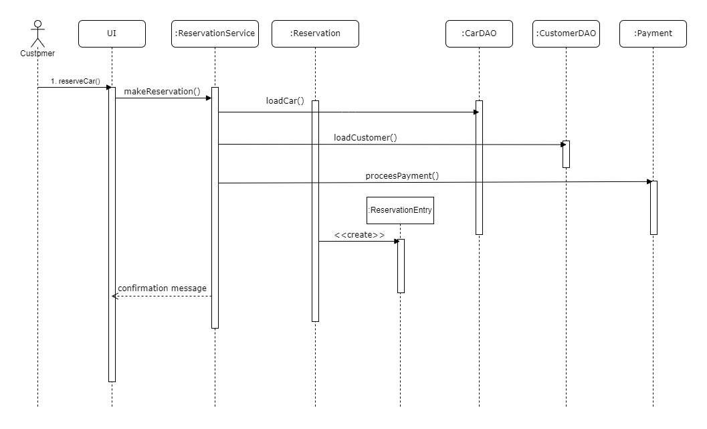
Sequence diagram

Slide 4
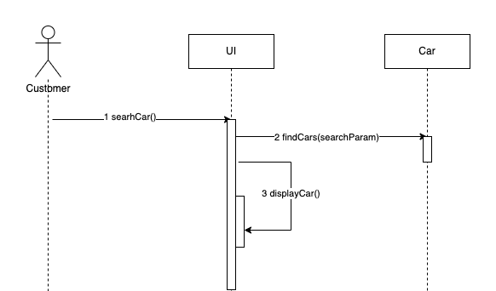
Customer-Search-Car

Slide 5
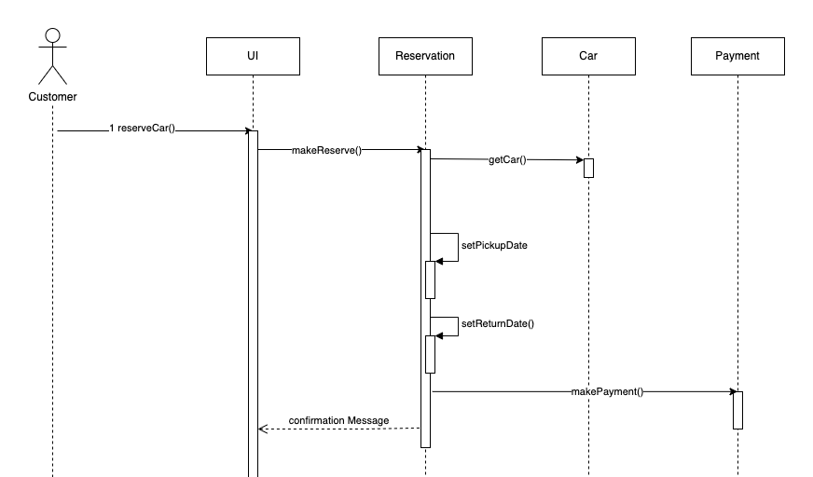
Customer-Reserve-Car

Slide 6
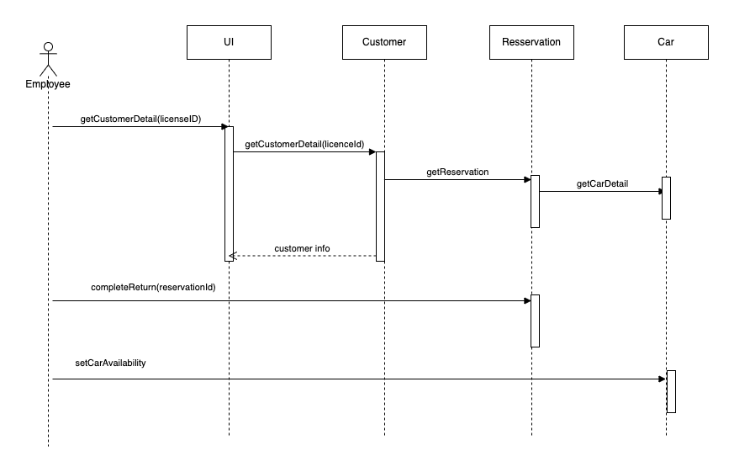
Confirm-Return

Slide 7
Class Diagram
Class diagrams are one of the most useful types of diagrams in UML as they clearly map out the structure of a particular system by modeling its classes, attributes, operations, and relationships between objects.

Slide 8
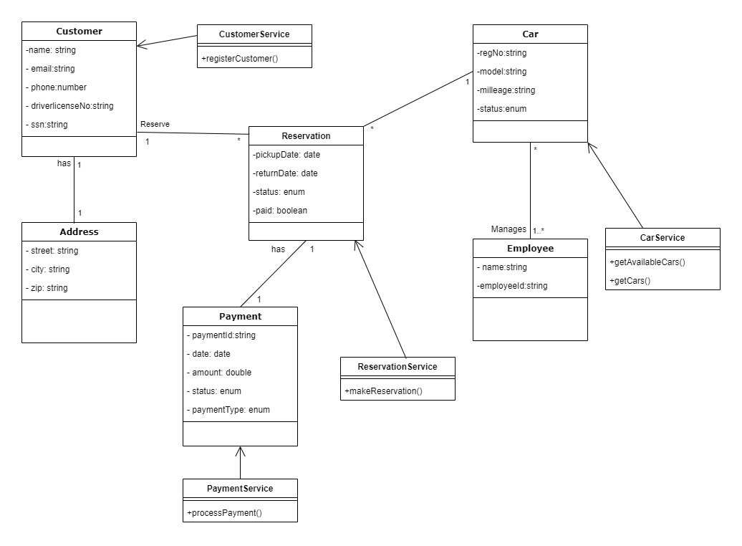
CLASS DIAGRAM

Slide 9
Architecture diagram
As a high-level diagram that shows the software's basic structure, this type includes software components, their relationships, and their properties. It can also convey relationships with external components such as users, databases, and services.

Slide 10
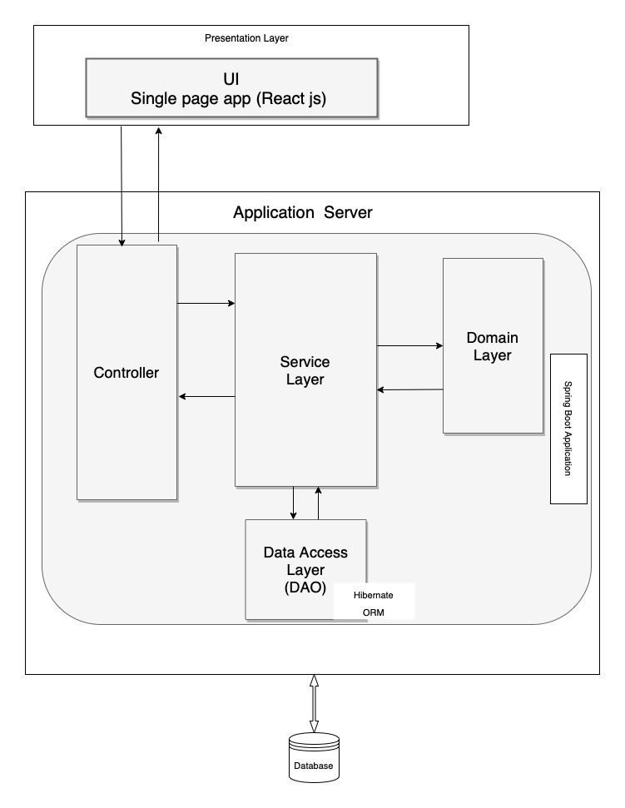
ARCHITECTURE DIAGRAM

Slide 11
THANK YOU!

